Slide 1
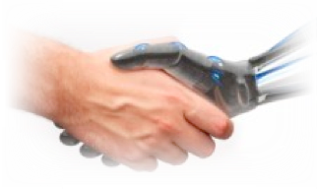
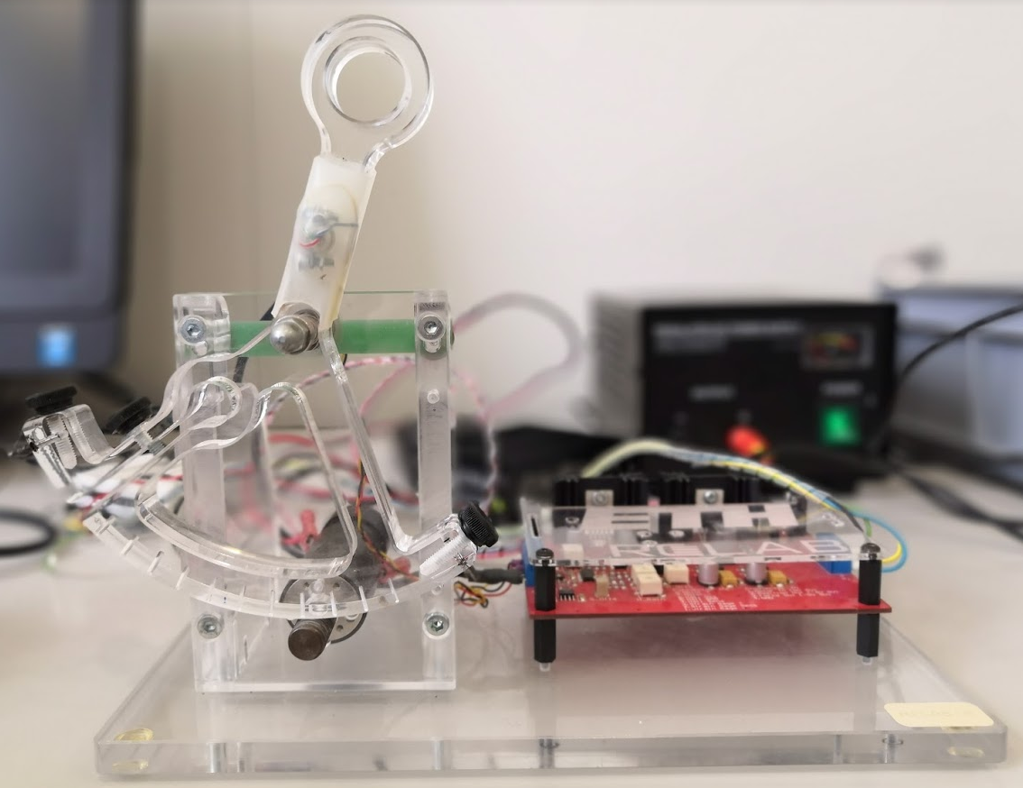
Admittance Control With Inner Position/Velocity Loop
Martin Wachter, Alberto Giammarino

Slide 2
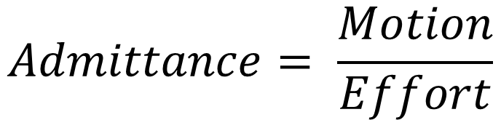
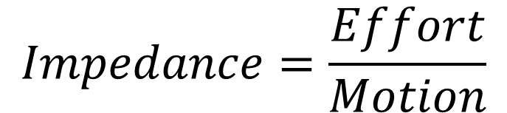
Introduction: Admittance Control
$$Admittance= \frac{Motion}{Effort}$$
$$Impedance=\frac{Effort}{Motion}$$
Notes:
Talk about difference of implementation of admittance and impedance controller (a few general words)

Slide 3
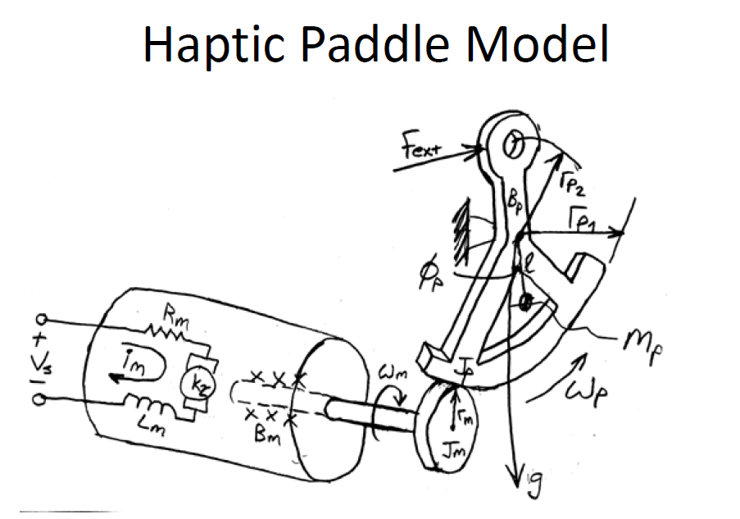
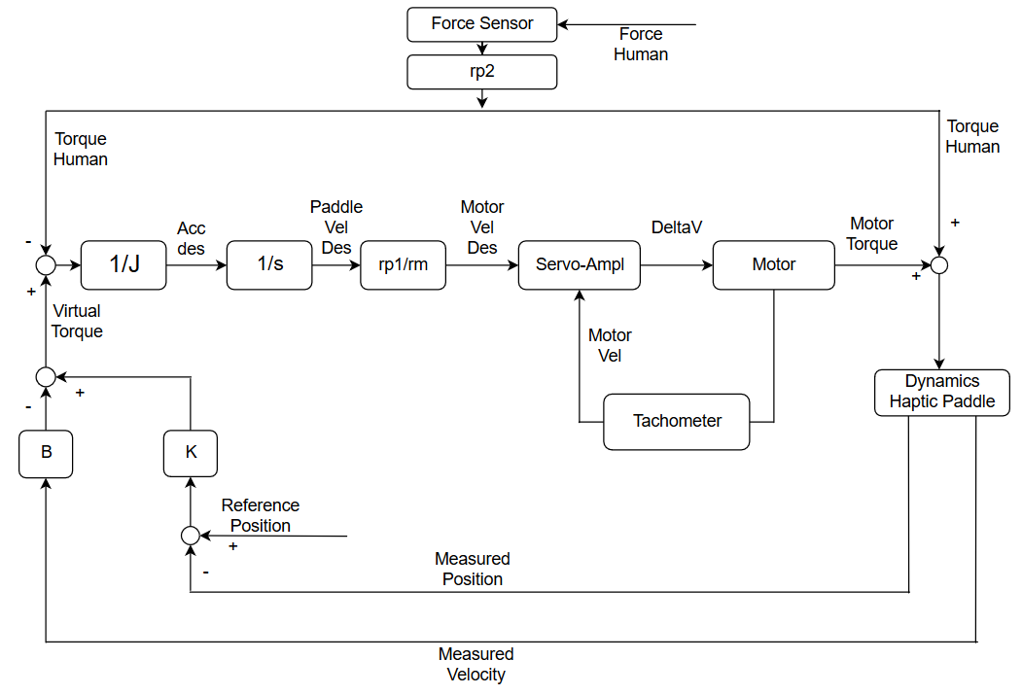
Block Diagram
J: Apparent inertia
B: Virtual damping
K: Virtual stiffness

Slide 4
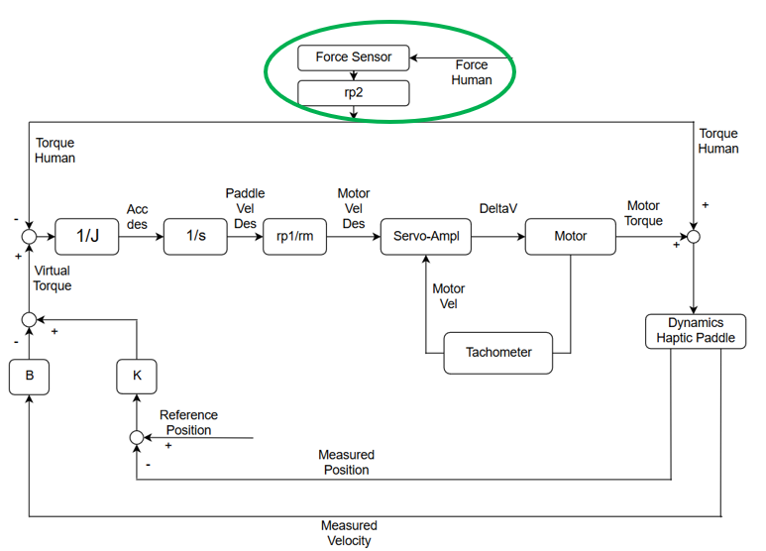
Force Sensor: Location

Slide 5
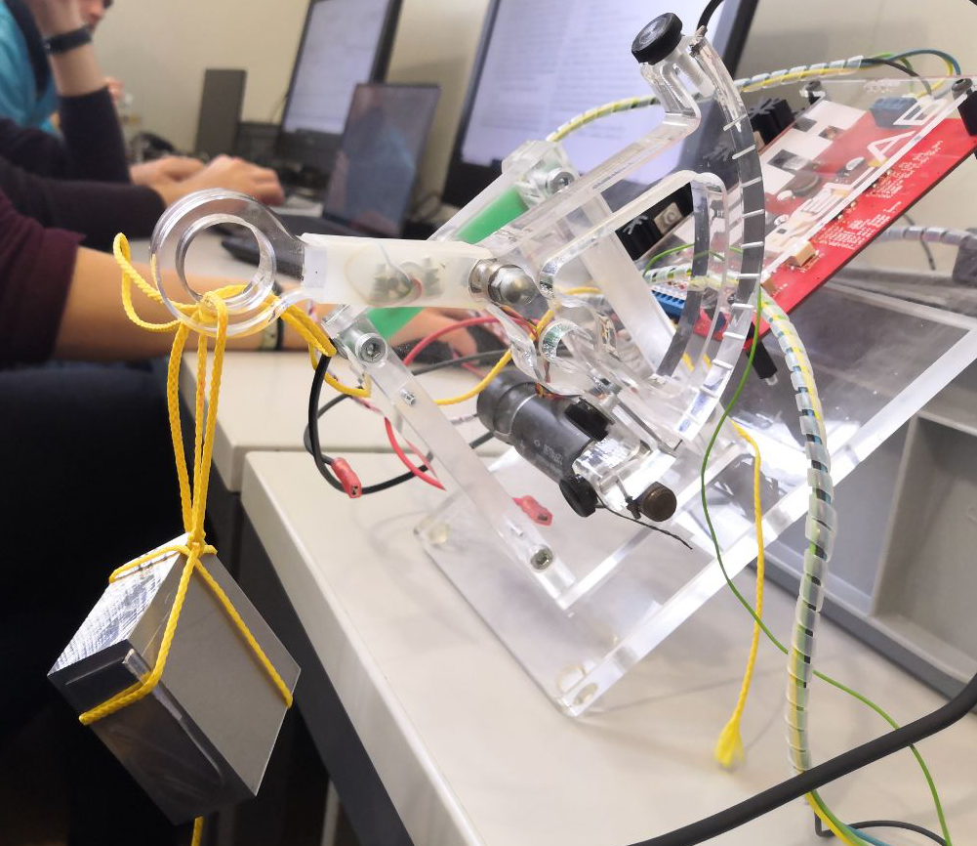
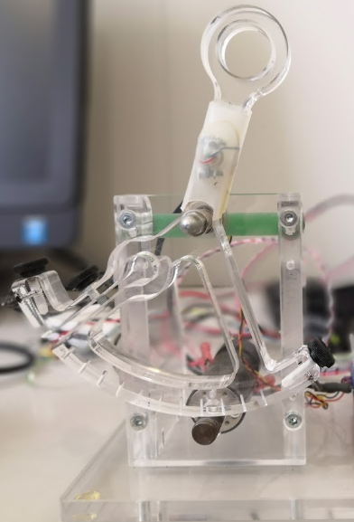
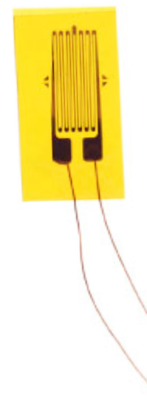
Force Sensor: Calibration
Notes:
Talk about the 90° angles

Slide 6
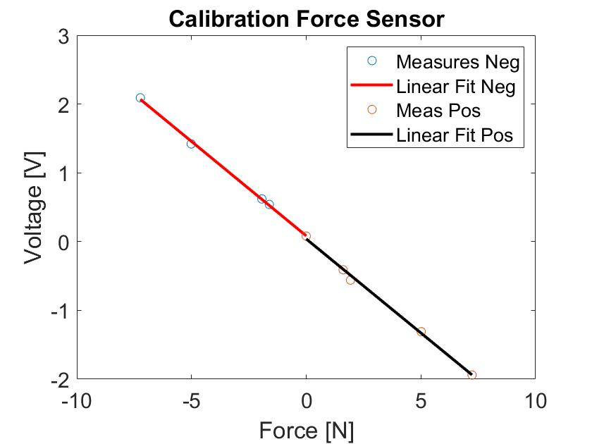
Force Sensor: Transfer Function
$$Force=0.2744∗Voltage+0.0838$$
Notes:
Talk about the compensation of the weight of the handle

Slide 7
Servo-Amplifier: Location

Slide 8
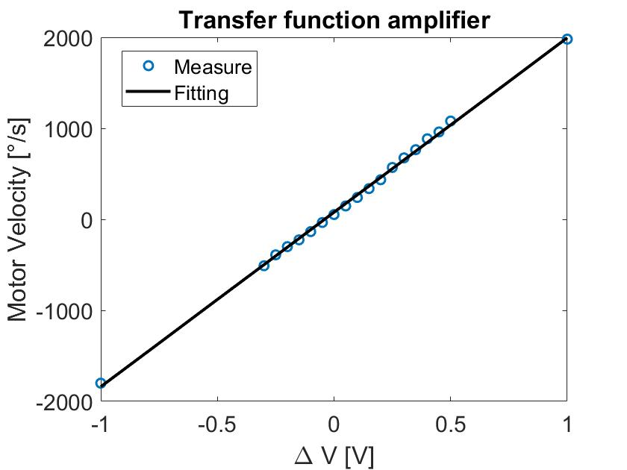
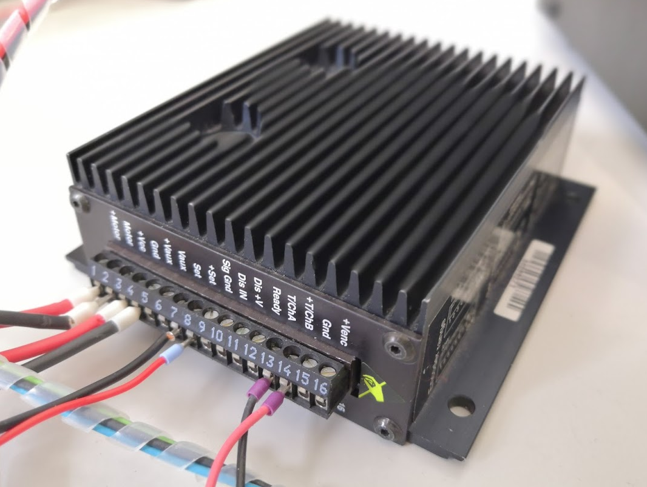
Servo-Amplifier: Transfer Function
$$Velocity=1917∗ΔV+77.5543$$
Notes:
Explain experiment to obtain it

Slide 9
Experiment 1: Enhancement of Transparency
Notes:
Explain how the experiment was leaded and say what was the aim (obtain transparency planes), explain tuning of K, B and J.

Slide 10
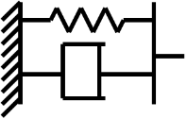
Experiment 2: Virtual M-B-K System

Slide 11
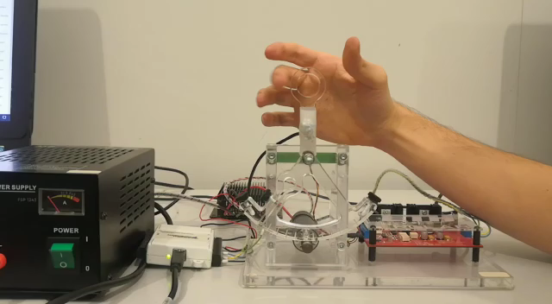
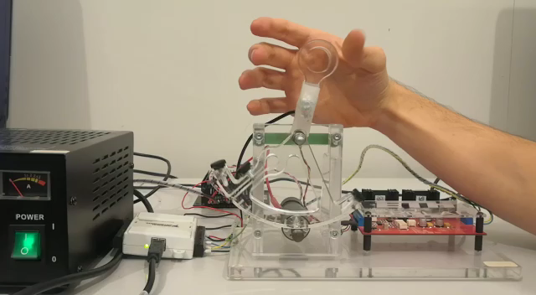
Experiment 1: Transparency
Notes:
Videos show the behaviour of our implemented admittance controller
Left: Motor not plugged in: Force and Inertia of physical System
Right: Our Implementation of Admittance Controller

Slide 12
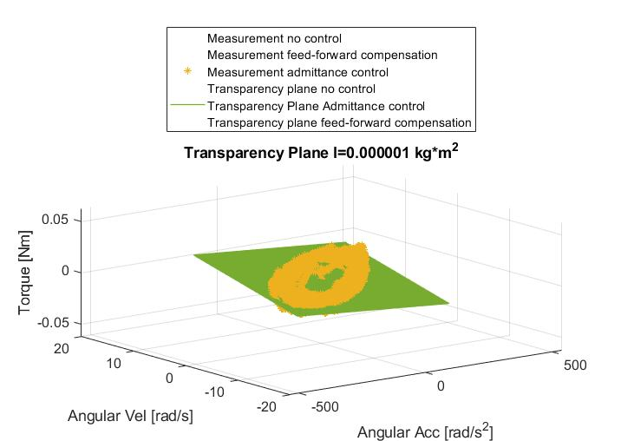
Experiment 1: Results-Transparency Planes
Notes:
Correlation Coefficient of planes R: 0.8
Purple – no control
Blue – Lab4 impedance control, where we added friction and gravity compensation
Green – our admittance control

Slide 13
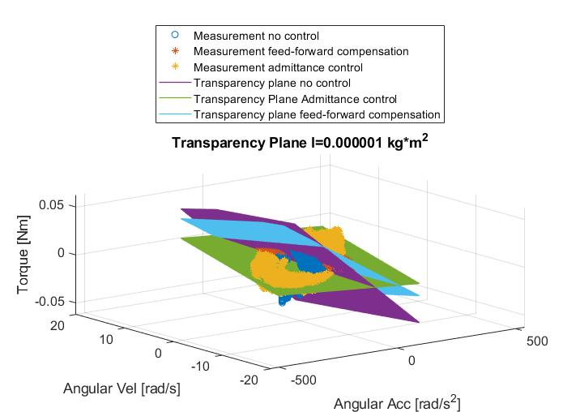
Experiment 1: Results-Transparency Planes
Notes:
First we created transparency plane for Admittance Control. To be able to compare it to the Lab 4 and the paddle without connection we also created these planes
Correlation Coefficient of planes R: 0.8
Purple – no control
Blue – Lab4 impedance control, where we added Friction and gravity compensation
Green – our admittance control
For next: To be better able to compare these three approaches we then created other plots: (next slide)

Slide 14
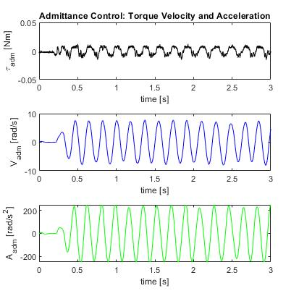
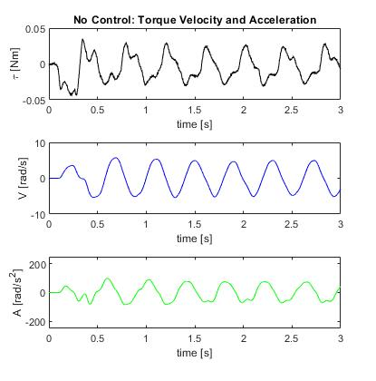
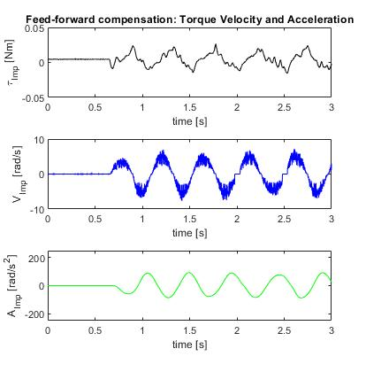
Experiment 1: Results-TVA Plots
Admittance Control
No Control
Friction/Gravity Compensation
Notes:
Left: Admittance Control
Middle: No Control
Torque much higher
Velocity lower
Acceleration lower
Right:Lab4 impedance Control

Slide 15
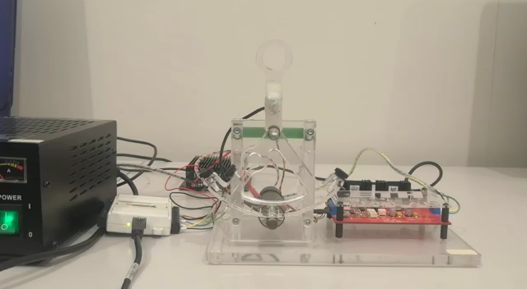
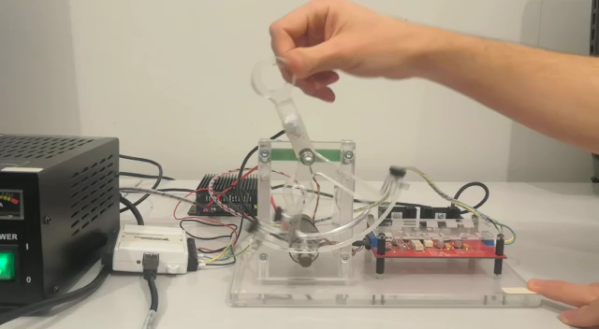
Experiment 2: Virtual M-B-K System
Notes:
Experiment2: Virtual Mass-Spring-Damper-System
Here virtual Damping B and Virtual Stiffness K were changed
Left: High K, Low B
Right: High Damping

Slide 16
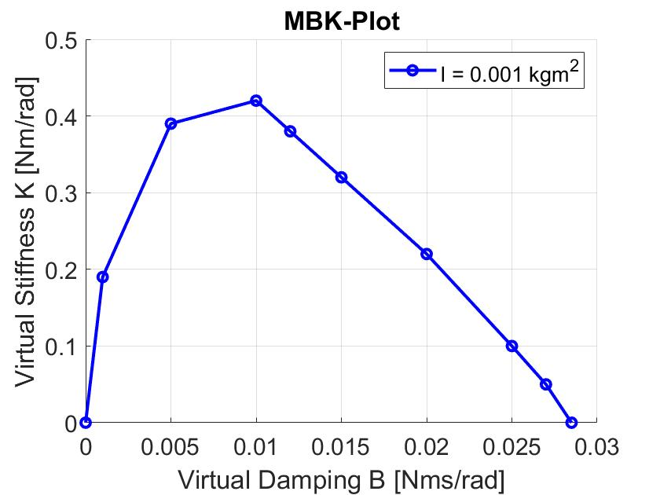
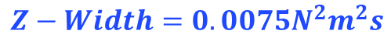
Experiment 2: Results - M-B-K-Plot
$$Z−Width=0.0075N^{2}m^{2}s$$
I: Inertia
Notes:
Advantage of Admittance Control: Mass or more specifically the Inertia can be changed.
We obtained B-K-Plots by fixing the inertia and then tuning the Virtual stiffness until it got unstable
Z-Widtd: 0.075 N^2*m^2*s

Slide 17
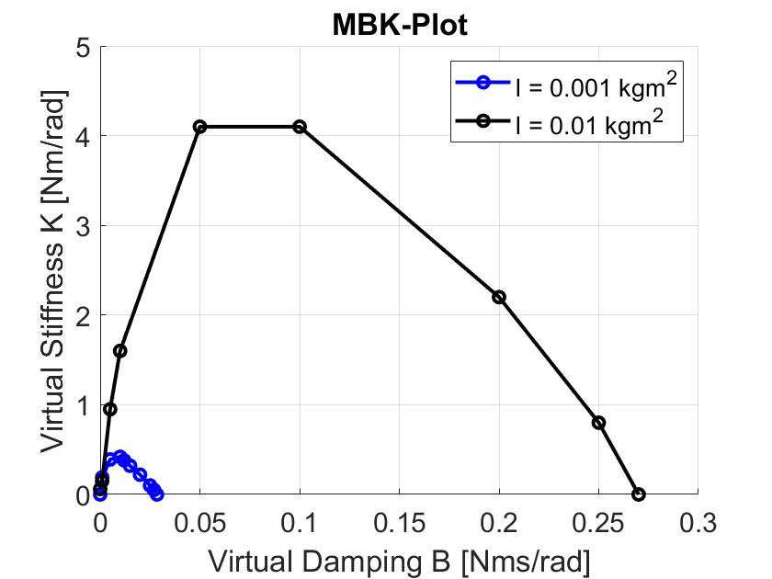
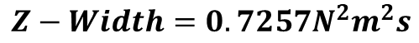
Experiment 2: Results - M-B-K-Plot
$$Z−Width=0.0075N^{2}m^{2}s$$
$$Z−Width=0.7257N^{2}m^{2}s$$
Notes:
K from 0.42 to 4.2

Slide 18
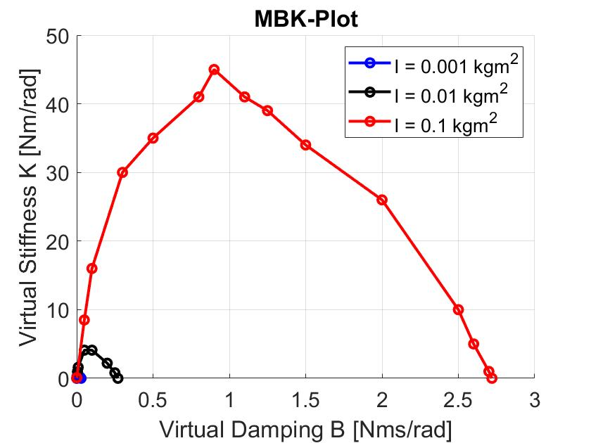
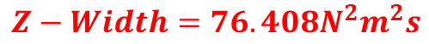
Experiment 2: Results - M-B-K-Plot
$$Z−Width=0.0075N^{2}m^{2}s$$
$$Z−Width=0.7257N^{2}m^{2}s$$
$$Z−Width=76.408N^{2}m^{2}s$$
Notes:
Maximum K from 4.2 to about 45 → linearly dependent on the Inertia
Z-width: defines Range of stable stiffness for different virtual Stiffnesses and virtual Dampings:
can grow by 4 orders of magnitude

Slide 19
Conclusions/ Outlook
Instability issues for high transparency
Wider z-width
Force sensor issues
Notes:
With this setup we got the following conclusions:
- All in all, system worked very well
When lowering the mass/inertia → we get an instable system
But Z-width can be higly increased so the damping and Stiffness can be increased to simulate a system with a high mass
We didn’t filter the the Force → high delay leads to instability when holding it
For physical human robot interaction the system is too unstable and only a trained person can use it
Therefore very expensive sensors exist.
If the device were to interact with humans, these problems would still have to be solved.
But to show the principle of an admittance control, this construction is very excellent.

Slide 20
Thank you for your attention!

Slide 21
